Slide 1




Slide 2
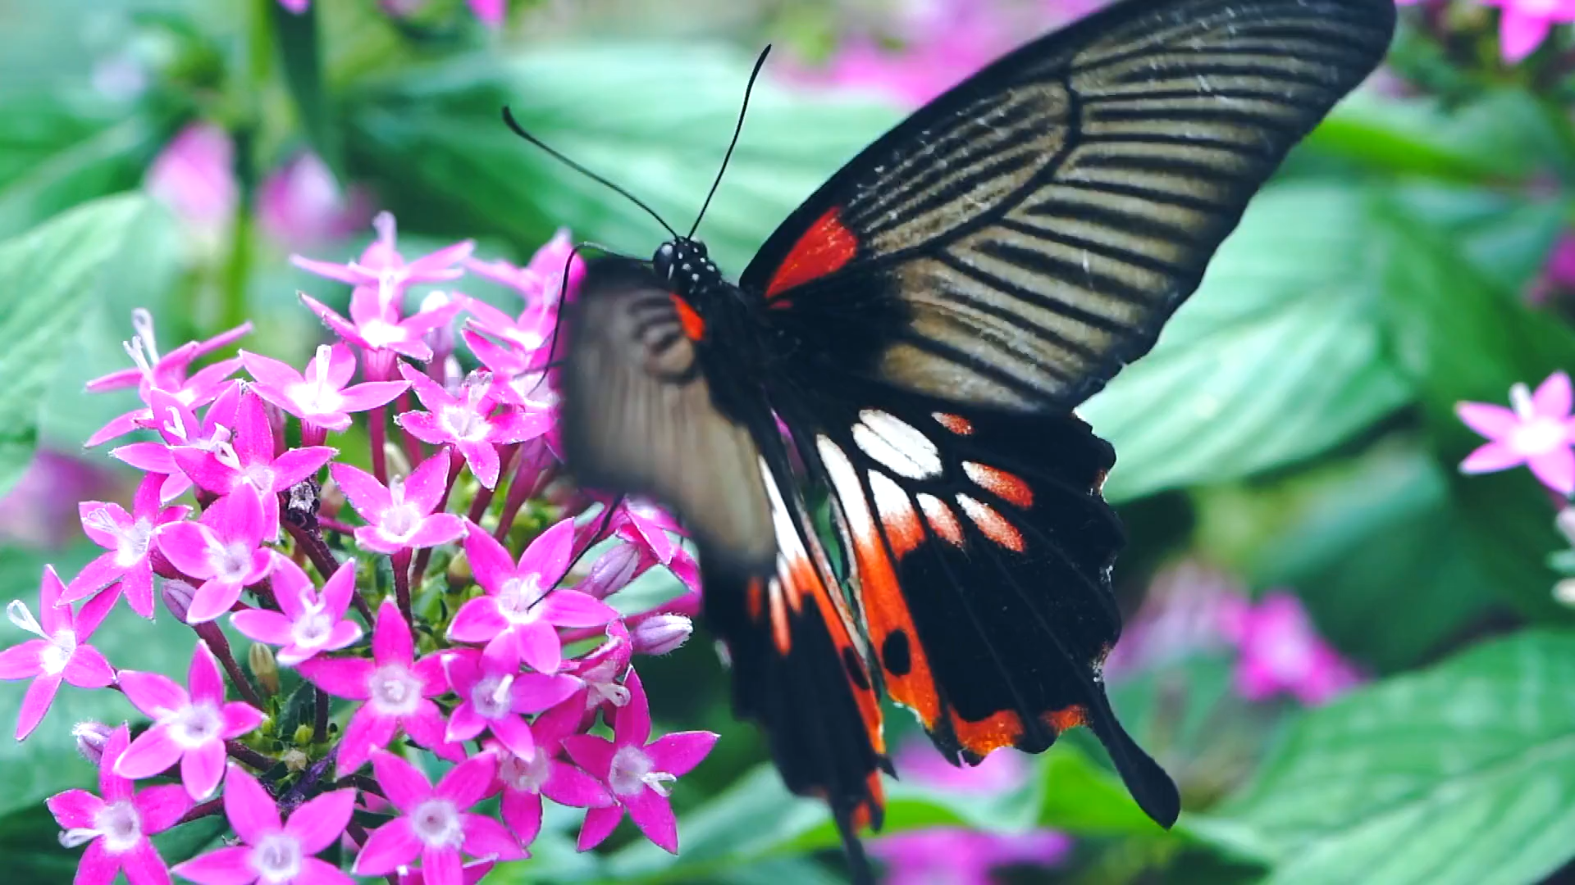

Metamorphosis:
Active Mobility

Slide 3
Project Goal
Develop and implement bottom-up measures with children to achieve lasting behavioural change to create child-friendlier neighbourhoods

Slide 4
Philosophy
Transforming public places into places for people

Slide 5
Project Partners
Tilburg
Munich
Zurich
Meran
Graz
Southampton
Alba Iulia
Notes:
Explain the different contexts
METAMORPHOSIS will include trial implementation cities with completely different neighbourhoods. The cities have different sizes: Munich (DE) ca. 1,5 Mio inhabitants, Zürich (CH) 400.000, Graz (AT) 290.000, Southampton (UK) 240.000, Tilburg (NL) 210.000, Alba Iulia (RO) 63.000 and Merano (IT) 40.000. Each city will participate with up to four different neighbourhoods, selected to have a wide variety: in size, structure, density and diversity. The scope ranges from mono-functional living areas to vibrant neighbourhoods with many different functions and a high share of migrants. There are newly developed areas as well as old deprived neighbourhoods, low-rise as well as high-rise areas, and also areas that are either more connected or are more isolated from the city centre. All selected cities are developing entirely new neighbourhoods by 2020

Slide 6
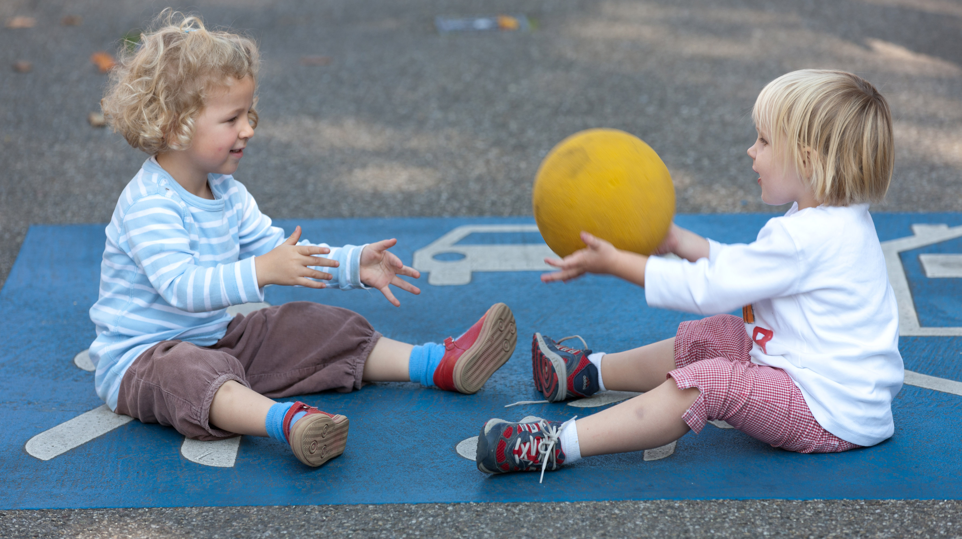



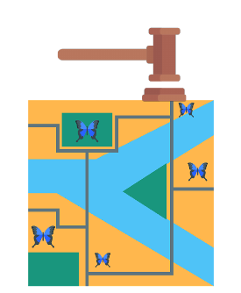
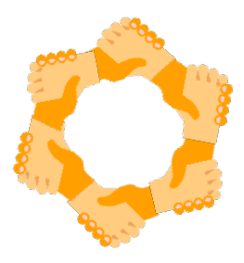

Activity Fields
Temporary street openings
Interventions in public space
Educational and innovative tools
Empowerment of active mobility
Crystallisation points
Planning procedures and integration in SUMP
Notes:
Metamorphosis focusses on 6 activity fields:
Temporary street openings close streets for cars and open them for people. They differ in duration: short time, one day, several days. The aim is to move from just once to regular, from short-term to long-term and from temporary to permanent change. Openings are organised througout the city and activities are held to show the potential of the space.
The aim of interventions in public space is to discourage car use and encourage greater sustainable mobility by all citizens. Resulting in a descrease of harmful effects of motorised vehicles on children, while promoting health benefits of active mobility, improving the accessibility and community usage of public spaces.
The aim of educational and innovative tools is to create awareness raising tools, tools to encourage change and involve children in a playful way. Yet effective way and enable them to specify and communicate their visions for our future cities and neighbourhoods. This measure also aims at including these tools within the curricula.
A major aim of METAMORPHOSIS is to empower children to become more independent users of active mobility and public space. When children get used to walking and cycling at an early age it is easier to continue with such acquired capabilities in the future.
The aim of chrystallisation points is to create attractive neighbourhood spaces where people can congregate and in which children and parents are encouraged to spend more time outside and use sustainable mobility methods and tools. To create places where people are offered a formal or more informal opportunities for communication, exchange and sharing, to foster greater community interaction.
All METAMORPHOSIS partners aim to improve planning procedures in their cities and to integrate it into their local SUMP. This to ensure that the METAMORPHOSIS thoughts, planning procedures and ideas live onward in the future planning of the seven cities and to be an example for other cities as well.

Slide 7
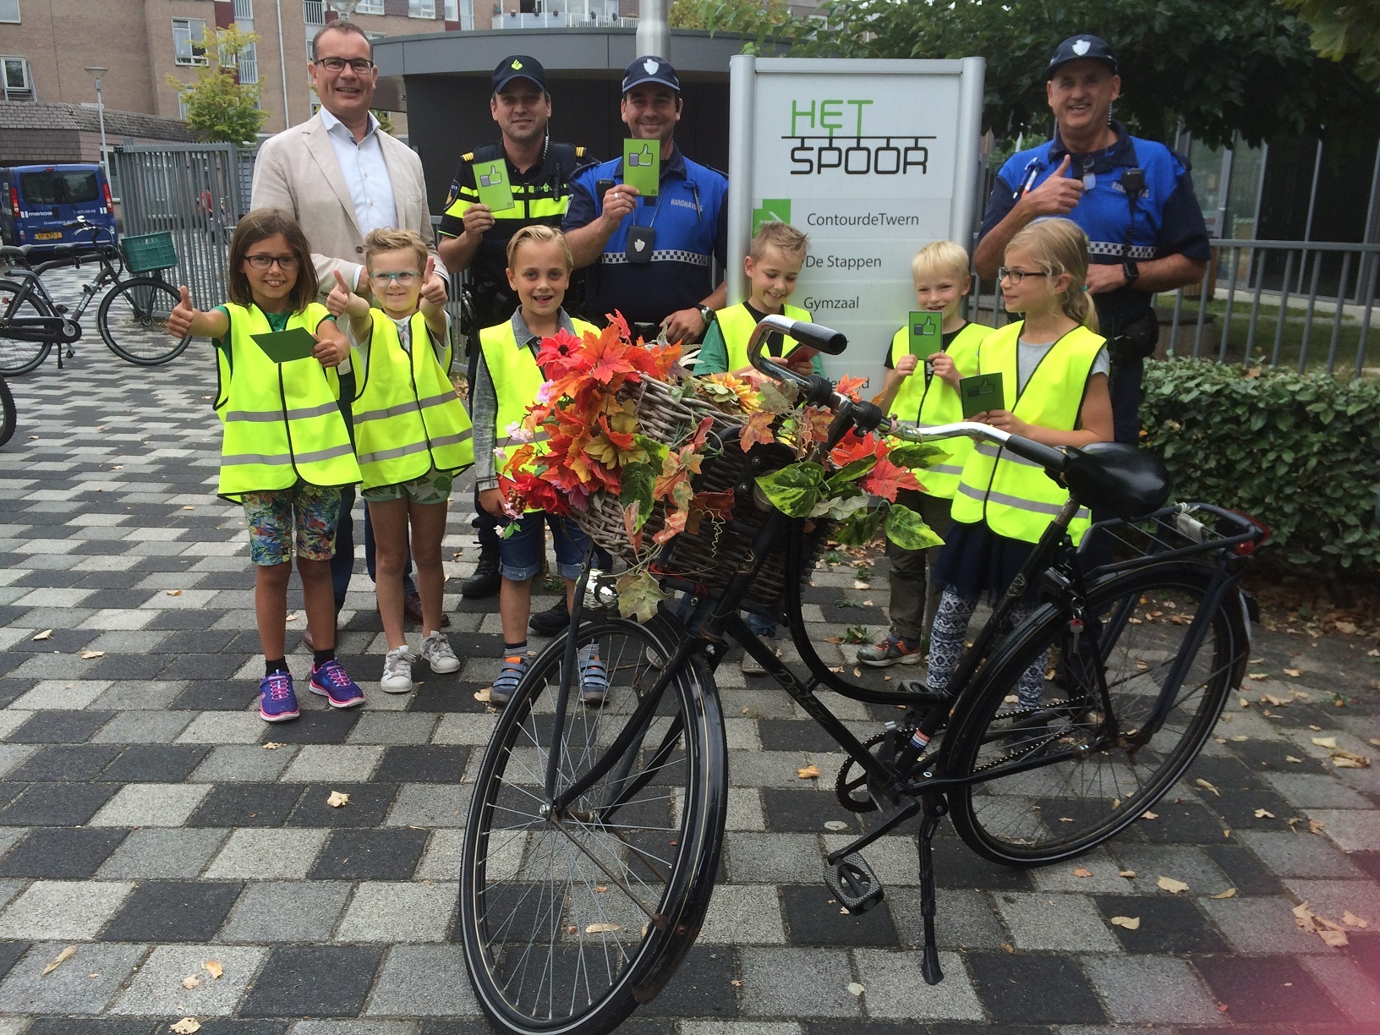
What is active mobility?
Active mobility
Notes:
A major aim of METAMORPHOSIS is to empower children to become more independent users of active mobility and public space. When children get used to walking and cycling at an early age it is easier to continue with such acquired capabilities in the future.

Slide 8
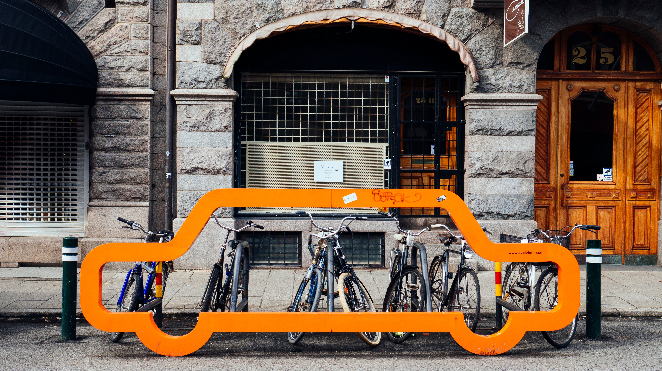
Goals
• Encourage the use of public space
as a playground and a meeting point.
• Raise the awareness for the topic
public space.
• Strengthen neighbourhood feelings.

Slide 9
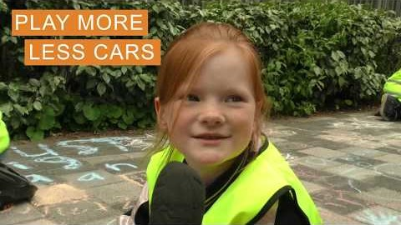

Slide 10
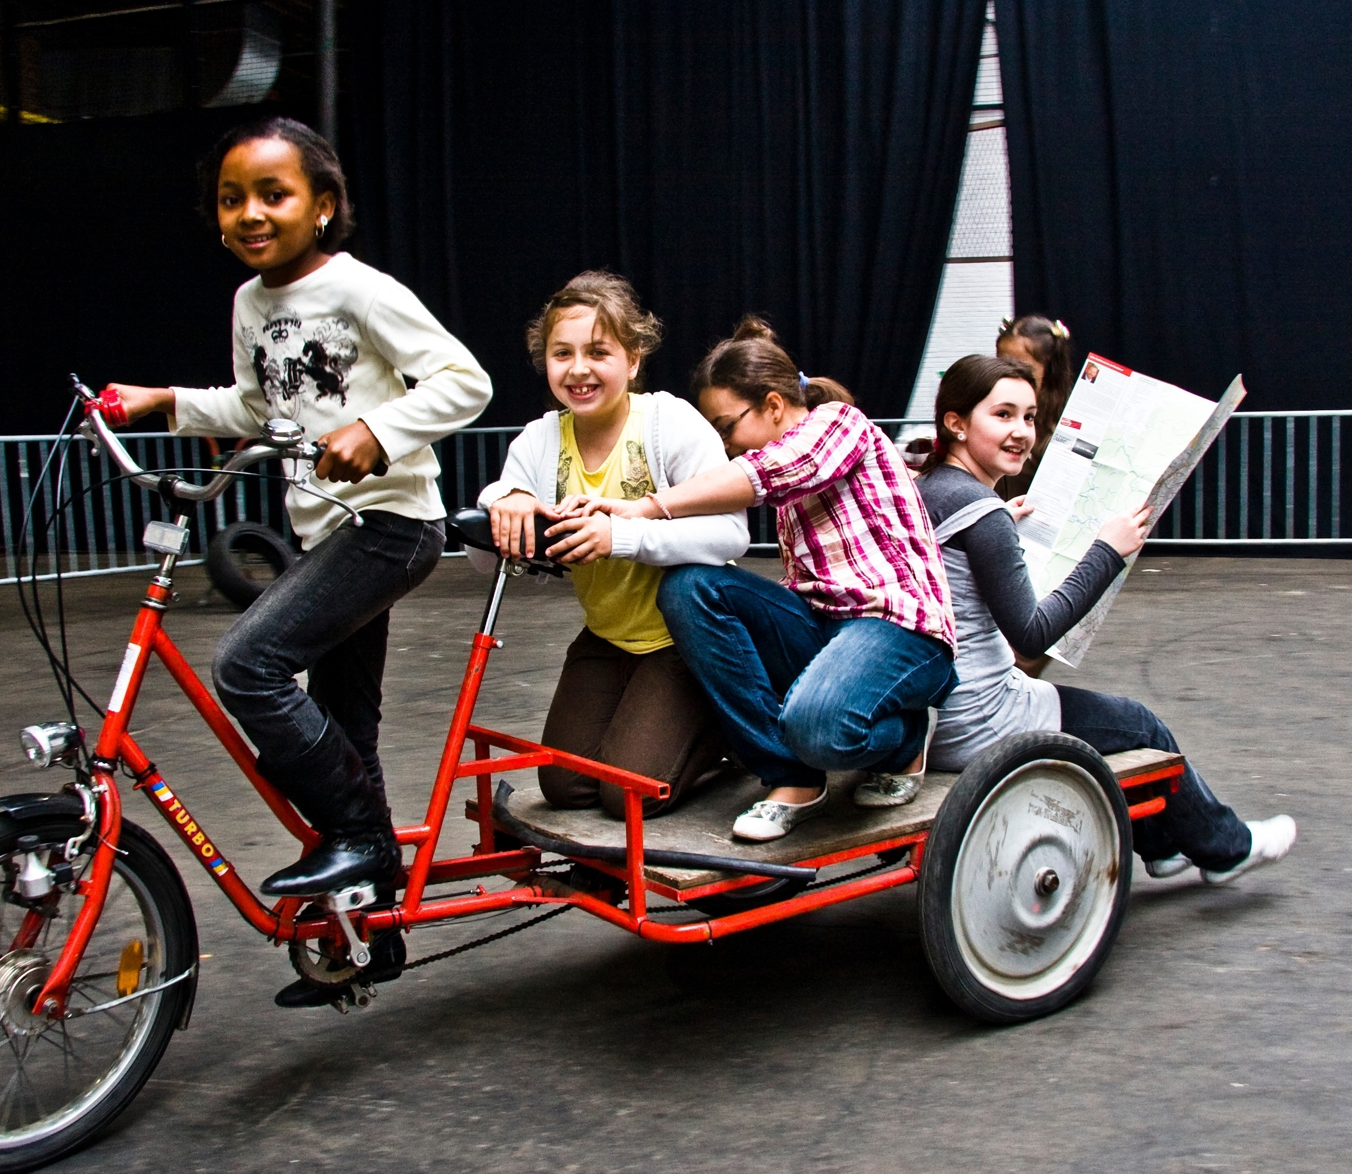
Example 1: Workshops and training activities
In all seven cities cycle trainings are given to primary school children to learn them about:
    How to ride a bike
    Which rules where to apply
    The importance of cycling to school.

Slide 11
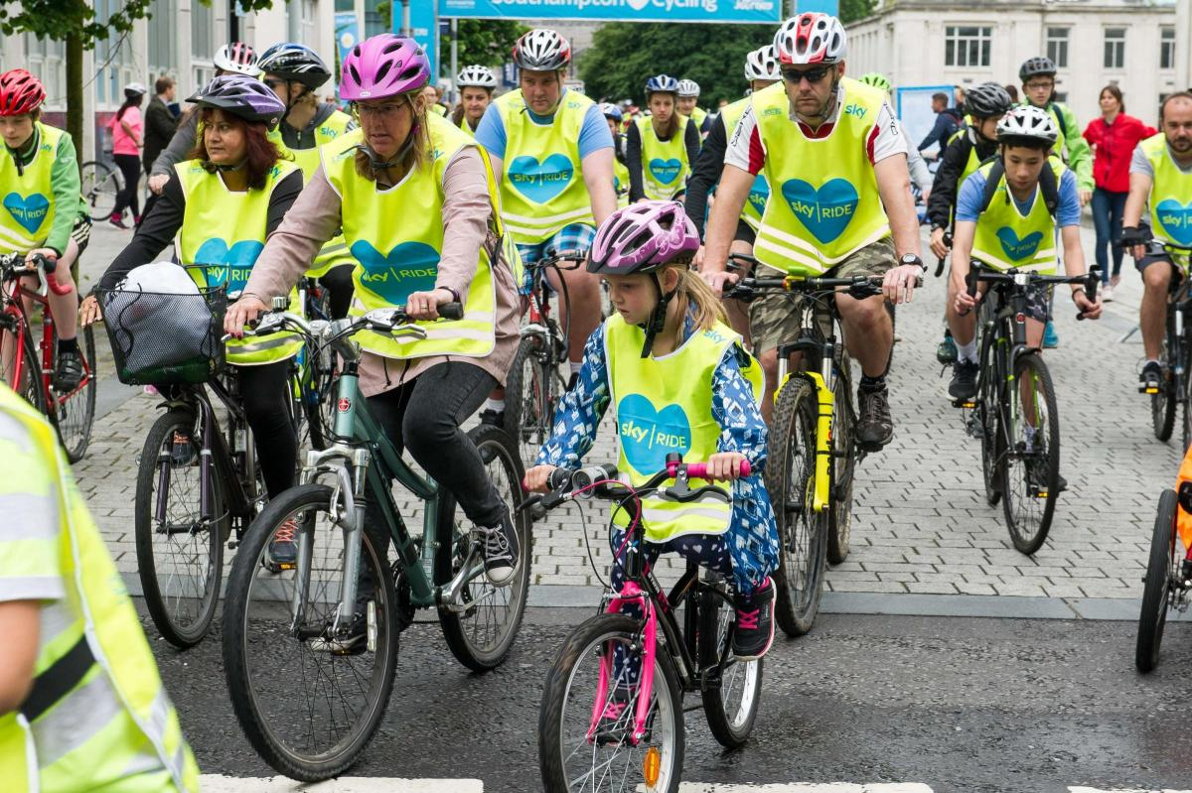
Example 2: Cycle events – Southampton, Graz, Munich
Let’s Ride Southampton is an annual cycling event in the city. It is a 6 km circuit through parts of the city centre, the football stadium, parks and The Common. The event is traffic free, some roads are closed for the day – and open to all, which means that trained Ride Leaders run group rides into the city centre on the day so people from the edges of the city can join. Along the route, several activities take place (cycling-themed but also music and art). Businesses located en-route were asked to contribute to the event by offering discounts on the day or decorating their premises.
Notes:
In 2019 over 10,000 people attended the event. During the event 11 businesses participated and 6 community groups were involved. 22 roads were closed during the event. Over 60 volunteers helped deliver the event. 5 led rides helped over 100 people into the city from surrounding neighbourhoods. 64% of people attending said that they were encouraged to cycle more. 41% were encouraged to look up routes in their local neighbourhood.

Slide 12
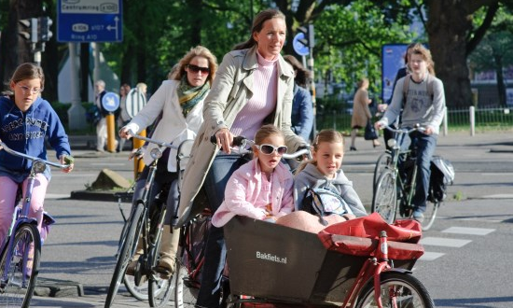
Example 2: Safe to school - Tilburg
This is a traffic safety exercise. For one week, children are
cooperating with city maintainers and are positioned in the
school environment. These environments have dangerous
spots for children. First the maintainers give a presentation
about traffic safety and instructions about the measure to
the class. By giving green or red cards to the passing road
users, the children give direct feedback to the driving
behaviour of the motorists which will mostly be parents.
Notes:
It is a positive measure for schools and maintainers to point out the traffic situation to the parents so they are willing to participate

Slide 13
Example 3: Interactive walking game - Munich
The game is designed to motivate children to actively walk or cycle in their everyday life. The goal is to find little blue boxes (45 boxes in total) which are hidden in their neighbourhood during seven weeks. By touching two boxes with their personal RFID card within one hour, 1 point per 100 meters is scored on the card. RFID cards etc. are distributed via schools or public libraries (for free). An online ranking showes which team is in the lead. At a award ceremony the best teams are getting awarded.
Notes:
The game was very well received and the level of active mobility was much higher during the game than it was before. Most users wished for a new implementation during the upcoming years. Children and their families were highly motivated to collect points. Engagement and interaction have improved; the game was proved to be subject to many conversations. On the other hand, several boxes were stolen and even reinstalled next to another box to score more points. Some participants also cheated by car use instead of walking or cycling.

Slide 14
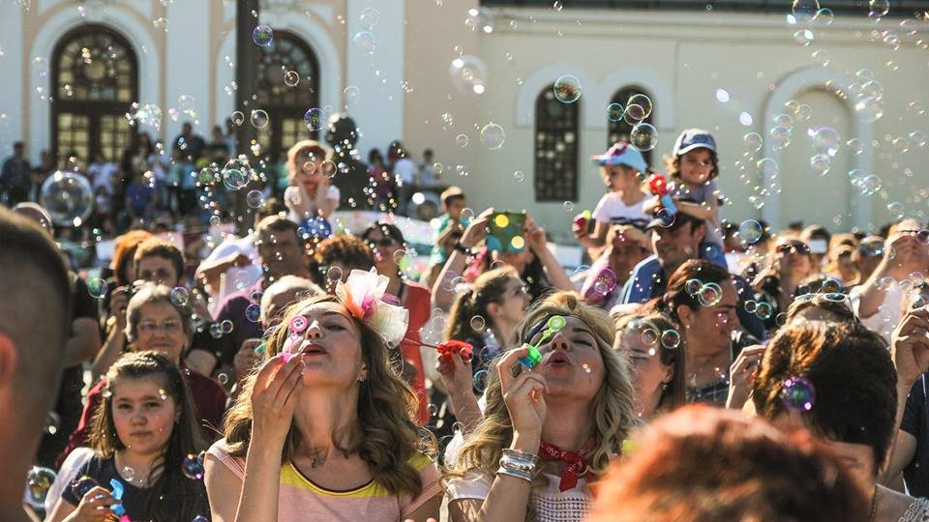
Tested soft measures, >500, 77% +/++
Working together with children ++
New tools for M&E
Enlighten the kids perspective
Change the mindset of cities.
Notes:
Plenty of soft measures are evaluated in various contexts paving the way for evidence-based soft measures >500 77%
Explores new ways of working with children and let them participate in every stem of the process (Cities are very satisfied with 46% of the measures, and 31% is satisfied. Results exceeded expectations, especially for those measures in cooperation with children where creativity and fun play a crucial role)
New monitoring and evaluation tools are developed. Focussing on making the result of soft measures measurable (by planning, implementing and evaluated we learn new ways every year.)
Kids have a radical different perspective on urban planning. This project enlightens this perspective through the workshops and it shows that if the assignment is clear kids come up with very useful results.
The mindset of the cities shifts. Tilburg is now rethinking all its school zones

Slide 15





Thank you!
Socials:
Website: www.metamorphosis-project.eu
YouTube: Childfriendly cities - METAMORPHOSIS
LinkedIn: EU Metamorphosis project
Facebook: EU Metamorphosis project
Instagram: eumetamorphosisproject

Slide 16


Presentation contents: Nick van Apeldoorn (BUas, Breda University of Applied Sciences, NL). Graphics slide 5, 6 are partly open source from Flaticon.
Video’s 2&14 used in this presentation are copyright free from: Pexels. Pictures © Metamorphosis.
All logo’s used in this presentation are from European organisations in which Metamorphosis participates
Questions/remarks: apeldoorn.n@buas.nl
“The project leading to this application has received funding from the European Union’s Horizon 2020 research and innovation programme under grant agreement No 723375”.
Project coordinator:
FGM-AMOR
Karl Reiter reiter@fgm.at
Notes:
N + H. End. name the logo’s again, refer to social media, thanks the audience

